Slide 1
SOFTWARE TESTING
What is Software Testing?
Software Testing is the process of evaluating and verifying that a software product or application is functioning right.
Software Testing can be stated as the process of Verifying and Validating whether a software or application is bug-free, meets the technical requirements as guided by its design and development, and meets the user requirements effectively and efficiently by handling all the exceptional and boundary cases.
The process of software Testing aims not only at finding faults in the existing software but also at finding measures to improve the software in terms of efficiency, accuracy and usability.
Who does Testing?
Software Tester
Software Developer
Project Lead/Manager
End User
Difference between Testing and Debugging:
Testing:
It involves the identification of bug/error/defect in the software without correcting it.
Debugging:
It involves identifying, isolating and fixing the problems/bug. Software Testing can be divided into two steps:
Verification
Validation

Slide 2
Project Vs. Product:
If a software application is developed for a specific customer based on their requirement, then it is called a Project.
If a software application is developed for multiple customers based on the market requirements, then it is called a Product.
Necessity of Software Testing:
To avoid risks (prevent)
To identify errors (detect)
To avoid extra costs
To gain customer confidence
To accelerate software development
To optimize business
To check software adaptability

Slide 3
Which SDLC model is best?
There is no model that we can consider as the best for software development process. But nowadays the
Agile model is currently the most popular and widely used by all the software organization. In this model after
every development stage (Sprint), the user is able to see whether the product meets his requirements. By this
way the risks are reduced as continuous changes are done depending on client’s feedback.
Types (Models) of SDLC:
Waterfall Model
Spiral Model
Rapid Application Development (RAD) Model
Iterative or Incremental Model
Prototype Model
V Model
Agile Model

Slide 4
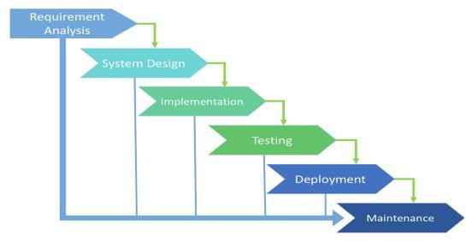
Types (Models) of SDLC:
Waterfall Model
Spiral Model
Rapid Application Development (RAD) Model
Iterative or Incremental Model
Prototype Model
V Model
Agile Model
Waterfall Model:
Waterfall is one of the earliest and most commonly used software development models (processes), in which the development process looks like the flow, moving step by step through the phases like analysis, design, coding, testing, deployment/installation, and support. So, it is also known as the “Linear Sequential Model”.
This SDLC model includes gradual execution of every stage completely. This process is strictly documented and predefined with features expected for every phase of this software development life cycle model.
Advantages of Waterfall Model:
Simple, easy to understand, and use.
Easy to implement because of its linear process.
Since requirement changes are not allowed, the chances of finding bugs will be less.

Slide 5
Initial investment is less since the testers are hired at the later stages.
Preferred for small projects where requirements are frozen (well understood at an early stage).
Disadvantages of Waterfall Model:
Requirement changes are not allowed.
If there is a defect in the Requirement that will be continued in later phases.
Poor model for a long and ongoing project.
Testing will start only after the coding phase.
Total investment is more because if the rework was done due to defects, leads to time-consuming and high investment.
Where we Use (Use Cases for) Waterfall SDLC Model:
The requirements are precisely documented.
Product definition is stable.
The technologies stack is predefined which makes it not dynamic.
No ambiguous (doubtful) requirements.
The project is short.
Spiral Model: PREE
Spiral Model is also known as an iterative model.
It is a combination of the Prototype and Waterfall model.
Spiral Model is mostly used in high-risk projects (in large and complex projects).
It is used when the requirement is large also unclear and complex.
Spiral Model overcomes drawbacks of Waterfall Model.
It consists of 4 stages Planning, Risk Analysis, Engineering, and Evaluation.
In every cycle new software [module] version will be released to the customer.
Software will be released in multiple versions. So, it is also called a version control model.

Slide 6
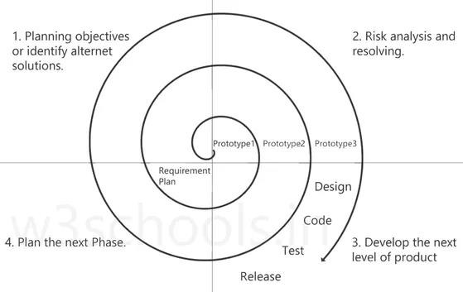
Stages:
1. Planning objectives or identifying alternative solutions: In this stage, requirements
are collected from customers, and then the aims are recognized and analyzed at the beginning of developing the project. If the iterative round is more than one, then an alternative solution is proposed in the same quadrant.
2. Risk analysis and resolving: As the process goes to the second quadrant, all likely solutions are sketched, and then the best solution among them gets selected. Then the different types of risks linked with the chosen solution are recognized and resolved through the best possible approach. As the spiral goes to the end of this quadrant, a project prototype is put up for the most excellent and likely solution.
3. Develop the next level of product: As the development progress goes to the third quadrant, the well-known and most required features are developed as well as verified with the testing methodologies. At the end of this third quadrant, new software or the next version of existing software is ready to deliver.
4. Plan the next Phase: As the development process proceeds in the fourth quadrant, the customers appraise the developed version of the project and report if any further changes are required. At last, planning for the next (subsequent) phase is initiated.

Slide 7
Prototype: A prototype is a blueprint of the software.
Initial requirements from the customer ---> PROTOTYPE ---> customer ---> Design, Coding, Testing....
Advantages of Spiral Model:
Suitable for large projects: Spiral models are recommended when the project is large, bulky, or complex to develop.
Risk Handling: There are a lot of projects that have un-estimated risks involved with
them. For such projects, the spiral model is the best SDLC model to pursue because it can analyze risk as well as handle risks at each phase of development.
Customer Satisfaction: Customers can witness the development of the product at
every stage and thus, they can let themselves habituate to the system and throw feedback accordingly before the final product is made.
Requirement’s flexibility: All the specific requirements needed at later stages can be included precisely if the development is done using this model.
Disadvantages of Spiral Model:
Requirement changes are NOT allowed in between the cycle.
Every cycle of the spiral model looks like a waterfall model.
There is no testing in the requirement and design phase.
Does not work for smaller projects.
It can be quite expensive.
=============================================================================
RAD Model:
RAD stands for “Rapid Application Development”. As per the name itself, the RAD model is a model to develop fast and high-quality software products by Requirements using workshops.
Prototyping and early, reiterative user testing of designs.
The re-use of software components.
Less formality in reviews and other team communication.
=============================================================================
Iterative Model:

Slide 8
In an iterative model application will get divided into small parts and development will be done by specifying and implementing only small parts of the software, which can be reviewed to identify further requirements.
This process is repeated, creating a new version of the software for each cycle of the model. The iterative model is very simple to understand and use. In this model, we
can’t start developing the complete software with full specification of requirements
=============================================================================
Prototype Model:
It is a trial version of the software. It is a sample product that is designed before starting actual testing.
This model is used when user requirements are not very clear, and this software is tested based on raw requirements obtained from the user. The available types of prototyping are Rapid, Incremental, Evolutionary, and Extreme.
Prototype Model will work like --
We will take basic requirements
Based on the discussion, we will create an initial prototype (A prototype – is a working model)
Once the working prototype is built, we will ask the client to check and use it
Next step will be to test and enhance
Again, we will call the user to check and use it, and again we will make changes as per the user's feedback until we get all the requirements from the user.
Once, all requirements are fulfilled and the client will agree, then the last step will be
signed off (Sign off - Deliver the product and finish the contract)
Advantages of Prototype Model:
Users are actively involved in the development
Missing functionalities can be identified easily
Based on user feedback, the SRS document is finalized
Disadvantages of Prototype Model:
Sample model is not used for actual implementation
Scope of the system may expand beyond original plans
=============================================================================

Slide 9
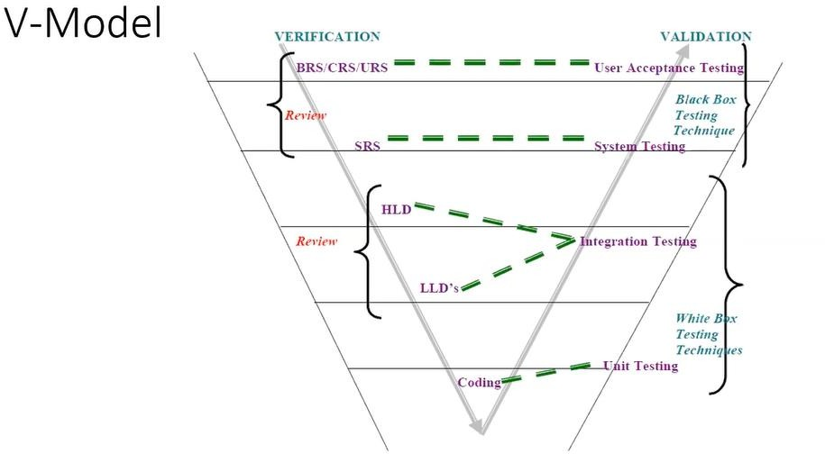
V Model:
In parallel to the software development phase, a corresponding series of test phases also runs in this model. Each stage ensures a specific type of testing is done, and once that testing is passed, only then the next phase starts.
When the requirement is well-defined and ambiguous (uncertain), we use V-Model.
It is also known as Verification and Validation model.
Verification: Design Phase:
Verification checks whether we are building the right product (software) (to check whether the specific requirements will meet or not).
Focus on documentation. Testing the project-related documents are called static testing.
Verification does not involve the code execution.
Verification typically involves Static Testing techniques like:
Reviews
Walkthroughs
Inspections
There are the various phases of the Verification Phase in the V-model,
BRS (Business Requirement Specification):
This is the first step where product requirements are understood from
the customer's side. This phase contains detailed communication to understand customers’ expectations and exact requirements.
SRS (Software Requirement Specification):

Slide 10
In this stage system engineers analyze and transfer the business of the proposed system to SRS by studying the user requirements document (BRS).
HLD (High-Level Design):
High-level design (HLD) explains the architecture that would be used to develop a system.
The architecture diagram provides an overview of an entire system,
identifying the main components that would be developed for the product and their interfaces.
LLD (Low-Level Design):
In the module design phase, the system breaks down into small modules.
The detailed design of the modules is specified, which is known as Low-
Level Design
Coding Phase:
After designing, the coding phase is started. Based on the requirements, a suitable programming language is decided. There are some guidelines and standards for coding. Before checking in the repository, the final build is optimized for better performance, and the code goes through many code reviews to check the performance.
Validation: Testing Phase:
Validation checks whether we are building the product (software) right (to check whether we are developing the right software).
Focus on software.
Validation typically involves actual testing.
Takes place after verifications are completed.
Here we use the below Dynamic testing techniques:
Unit Testing
Integration Testing
System Testing
UAT
Advantages of the V Model:
Testing is involved in each and every phase.
Every stage of the V-shaped model has strict results, so it is easy to control.
Testing and verification take place in the early stages.
Good for small projects, where requirements are static and clear.
Testing Methods like planning, test designing happens well before coding.

Slide 11
Disadvantages of the V Model:
Documentation is more.
If any changes happen in the midway, then the test documents along with the
required documents, must be updated.
Initial investment is more.
Very rigid and least flexible.
Software is developed during the implementation stage, so no early prototypes of the software are produced.
When to use V Model:
The V-shaped model should be used for small to medium-sized projects where requirements are clearly defined and fixed.
Experienced technical resources are available
Is Waterfall Model and V Model being the same.?:
V Model is the updated version of Waterfall Model.
=============================================================================
Static Testing Techniques:
We use Static Testing Techniques on the Verification side in V Model.
Review
Walkthrough
Inspection
Review:
Review conducts on documents to ensure correctness and completeness.
Requirement reviews
Design reviews
Code reviews
Test Plan reviews
Test cases reviews etc.
2. Walkthrough:

Slide 12
Verification:
It is a process of confirming whether the software meets its requirement or not.
Process of examining/reviewing of work product.
Are we building the product right?
It is a QA activity.
It’s a static process performed at compile time.
Cost and Time effective.
Activities involved in this are inspections, reviews, walk-through.
Validation:
It is a process of confirming whether the software meets user’s requirement or not.
Process of executing a product and examining how it behaves.
Are we building the right product?
It is a QC activity.
It’s a dynamic process performed at run time.
It is performed by a QC team.
Cost and time taking.
Activities involved in this are testing the application.
Importance of Software Testing:
Defects can be identified early.
Improves quality of software
Increased customer satisfaction
It helps with scalability.
Saves time and money.
What Is Software Testing Life Cycle?
Software Testing Life Cycle is a process used to test software and ensure that quality standards are met. Tests are carried out systematically over several phases. During product development, phases of the STLC may be performed multiple times until a product is deemed suitable for release.

Slide 13
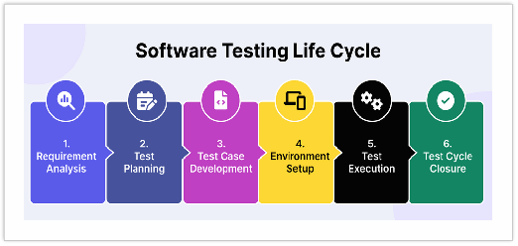
Common Activities included in STLC are:
Analysis of client and stakeholder system requirements.
Creation of a traceability matrix.
Identification of testing techniques and types needed for each feature.
Prioritization of features to be targeted.
Analysis of how tasks can be automated.
Identification of environment information.
STLC Phases:
Software Testing Life Cycle contains the following steps:
Requirement Analysis
Test Plan Creation
Test Case Development
Test Environment Setup
Test case Execution
Test Cycle Closure
Requirement Analysis:
In this phase, the team reviews the Software Requirement Document (SRD) and other related documents. Identifying any ambiguities in the documents.
In this phase, the Testing team will also analyze whether we can automate the product using the Automation Feasibility Report.

Slide 14
If the score is above 70%, they will go for Automation. Here, the testing team will prepare one report called Requirement Traceability Matrix (RTM) document.
RTM is used to map all your business requirements with the test cases. If any business requirement is missed, we can find it easily with the help of this RTM document.
Test Planning:
This phase gets started once the requirement – gathering phase is completed.In this phase, only Test Lead and Manager may be involved. They prepare two documents called Test plan and Test Strategy.
Test Strategy:
It is the High-Level Document which contains the overall approach.
It varies from organization to organization.
But inside the organization, it is the same for everyone.
Test Plan:
It is a document that contains all the planning activities like scope and features to be tested, objective, what to be tested, cost & time estimation, staffing & training.
It varies from project to project like identifying the test deliverable and milestones.
Assigning roles and responsibilities to the testing team.
Reviewing and approving the test plan.
At the end of this phase, the testing team should have a detailed plan for the testing activities that will be performed. This will help to ensure the testing process is well organized and that the testing team is able to deliver high-quality results.
Test Case Development:
In this phase, the testing team prepares the Test cases and required Test Data for the testing. When the test cases are prepared then they are reviewed by the quality assurance team.
If it is an automation, the testing team have to prepare Test scripts.

Slide 15
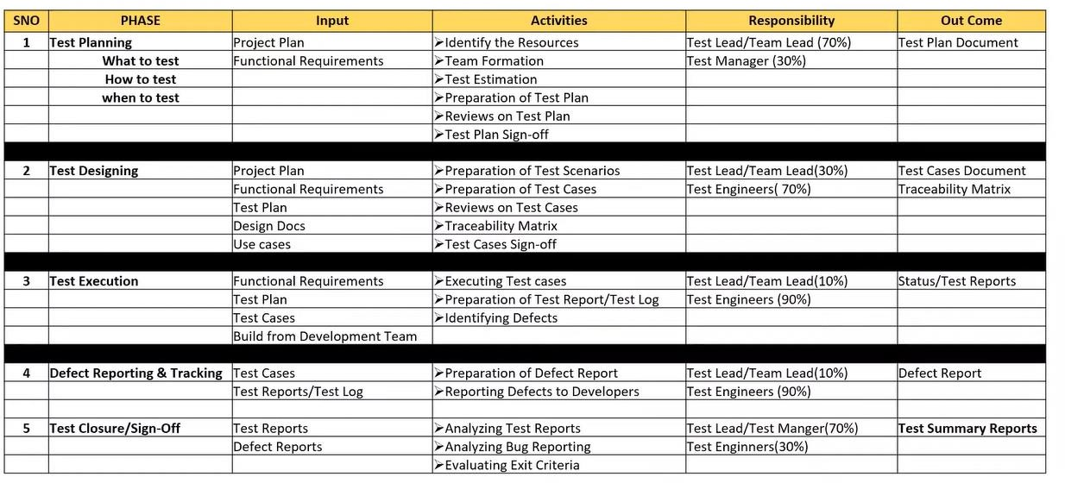
The activities that take place during the Test case Development stage is:
Writing test cases that are clear, concise and easy to understand.
Creating test data and test scenarios that will be used in the test cases.
Identifying the expected results for each test case.
Reviewing and validating the test case.
Updating the RTM to map requirements to test cases.
Test Environment Setup:
The necessary hardware, software and network configurations are set up for Test execution. This is an independent activity and can be started along with test case development. In this process, the testing team is not involved, either the developer or the customer creates the testing environment.
Test Execution:
After the test case development and test environment setup test execution phase gets started.
In this phase, the testing team starts executing test cases based on prepared test cases.

Slide 17
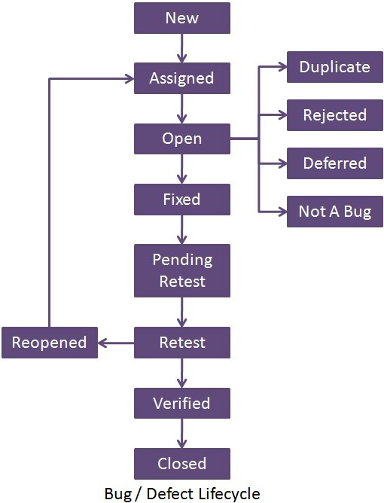
Defect Life Cycle:
Defect Logging:
Any defects or issues that are found during the test execution are logged in a defect tracking system, along with details such as severity, priority and description of this issue.
During testing, if tester find any bug/defect, report that to the developer immediately.
The developer will fix the issue and reassign it to the testing team.
Then, the testing team will retest again. So, until all the bugs get closed, we should not close the testing process cycle.
It is important to note that test execution is an iterative process and may need to be repeated multiple times until all identified defects are fixed and the software is deemed fit for release.

Slide 18
Test Closure:
Test closure is the final stage of the STLC where all testing related activities are completed and documented. The main activities that take place during the test closure stage include:
Test Summary Report
Defect Tracking
Test Environment Clean-up
Test Closure Report
Knowledge Transfer
Feedback and Improvements
Test Summary Report:
A report is created that summarizes the overall testing process, including the number of test cases executed, the number of defects found and the overall pass/fail rate.
Defect Tracking:
All defects that were identified during testing are tracked and managed until they are resolved.
Test Environment Clean-up:
The test environment is cleaned up, and all the test data and test artifacts are archived.
Test Closure Report:
A report is created that documents all the testing related activities that took place, including the testing objectives, scope, schedule and resources used.
Knowledge Transfer:
Knowledge about the software and testing process is shared with the rest of the team and any stakeholders who may need to maintain to support the software in the future.

Slide 19
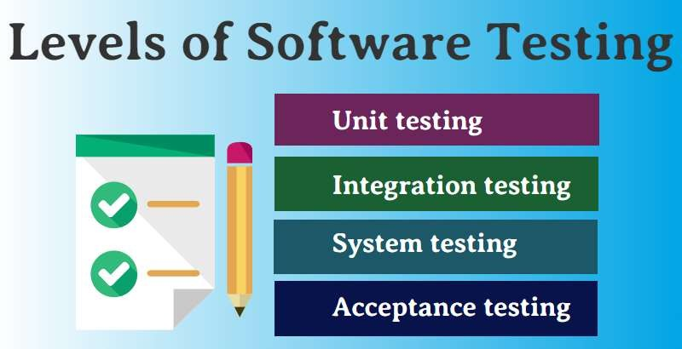
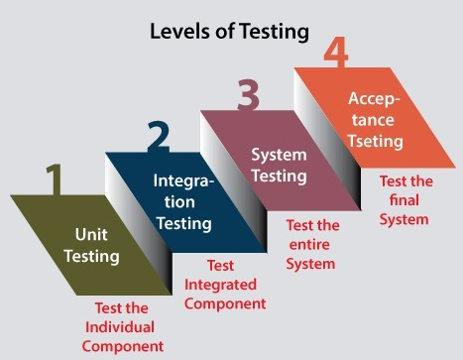
Feedback and improvements:
Feedback from the testing process is collected and used to improve future testing processes.
Levels of Testing in Software Testing:

Slide 20
Unit Testing:
A unit is the smallest testable part of any software.
It is the level of software testing where individual components of a software are tested.
Unit testing is a White box Testing technique that is usually performed by the developer.
Integration Testing:
It is a level of software Testing where Individual units are combined and tested as a group.
Integration Testing focuses on checking data communication amongst the modules.
Methodologies of Integration Testing:
Big bang Approach
Incremental Approach
System Testing:
It is a level of software Testing where a complete and integrated software is tested. The purpose of the test is to evaluate the system’s compliance with specified requirements.
It falls under The Black Box Testing category of Software Testing.
It is the third level of testing performed after Integration Testing and before Acceptance Testing.

Slide 21
Acceptance Testing:
It is a level of the software Testing process where a system is tested for acceptability.
Internal Acceptance Testing, known as Alpha Testing, is performed by members of the organization. Usually, it is done by the members of Product Management, Sales and Customer Support.
User Acceptance Testing, known as Beta Testing, is performed by the end users of the software. They can be the customers themselves or the
customers’ customers.
Regression Testing:
After enhancements in the application, testing is done to ensure that the existing functionality of the application is working fine.
Retesting:
It is running the previously failed test cases again on the new software to verify whether the defects posted earlier are fixed or not.
Smoke Testing:
Build Verification test done to ensure the major functionalities of the application are working fine.
Sanity Testing:
It is done to ensure that the addressed scope of the release is tested and the same works fine.
Exploratory Testing:
It is done with the experience of the tester to explore the application to understand the functionality and find the defects. This is done without formal documentation.
Secure Testing:
It is done to check how the application is secure from internal and external threats like viruses, malicious programs.

Slide 22
Explain what should your QA documents include?
QA testing document should include
List the number of defects detected as per severity level
Explain each requirement or business function in detail
Inspection reports
Configurations
Test plans and test cases
Bug reports
User manuals
Prepare separate reports for managers and users
=============================================================================

Slide 23
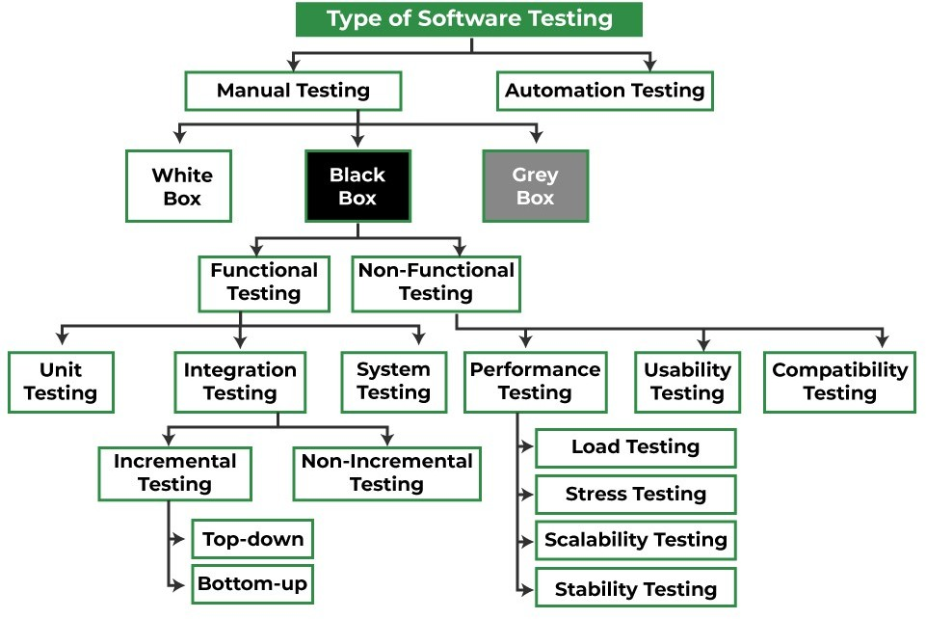
Types Of Testing:
Manual Testing:
It is a kind of software Testing in which a Software tester develops and executes the test cases without using any automated testing tools.
White Box Testing:
It is done by developers.
This testing is focused on Internal Structure and logic of the code.
Structural Based Technique.
They are also called Glass box testing.
Black Box Testing:
It is done by testers.
This testing focuses only on what kind of Inputs we are giving. And it checks whether the output meets the requirements.
This is a specification-based technique.
Gray Box Testing:
It is a combination of white-box testing and black-box testing.
The aim of this testing is to search for defects, if any due to improper structure or improper usage of application.
Methods
of Testing (Testing Methods) (White box, Black box, Grey box)
Black Box testing
White Box Testing
Grey Box Testing

Slide 24
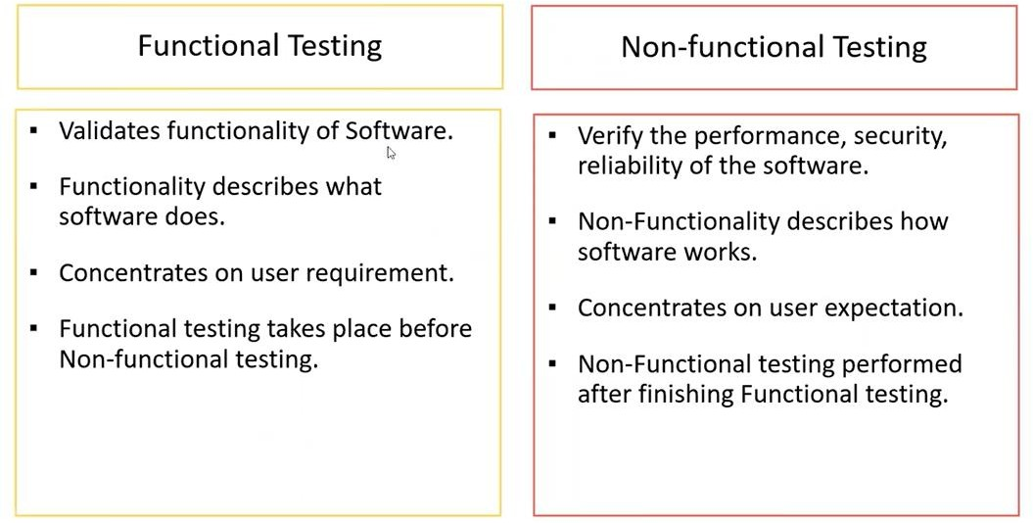
Test Design Techniques (During Designing Test Cases) (for Black Box Testing):
Equivalence Class Partitioning (ECP)
Boundary Value Analysis (BVA)
Decision Table
State Transition
Error Guessing
Equivalence Class Partitioning (ECP):
Partition data into various classes and we can select data according to class then test. It reduces the number of tests cases and saves time for testing.
Value Check.
Classify/divide/partition the data into multiple classes.
Shrikant S.
sssnashik@gmail.com

Slide 25
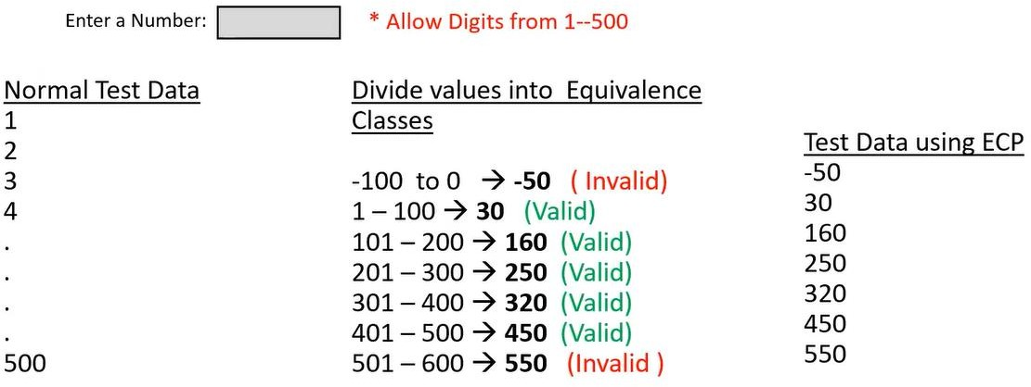
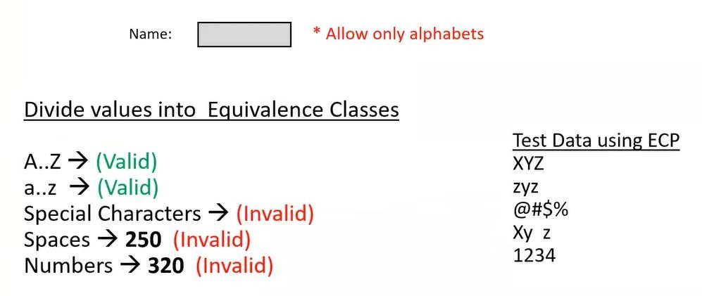
Boundary Value Analysis (BVA):
Mainly we focus on boundaries of the value.
Here we consider 6 factors: Min, Min + 1, Min - 1, Max, Max + 1, Max – 1.
Shrikant S.
sssnashik@gmail.com

Slide 26
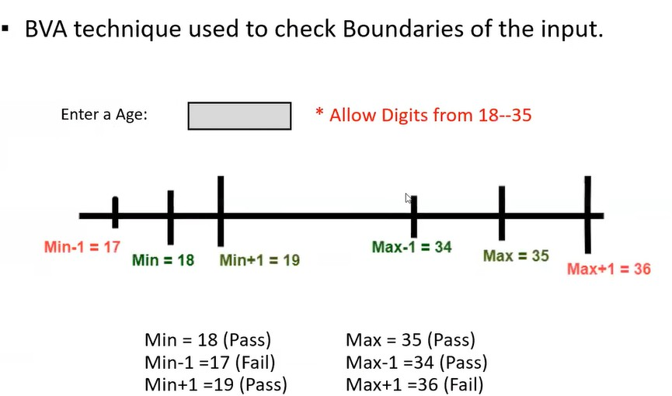
*** In Input Domain Testing mostly we use ECP and BVA techniques.
*** Input Domain testing: The value will be verified in the textbox/input fields.
Decision Table:
Decision Table is also called a Cause-Effect Table.
This technique will be used if we have more conditions and corresponding actions.
In the Decision table technique, we deal with combinations of inputs.
To identify the test cases with a decision table, we consider conditions and actions.
If we have a greater number of conditions/actions, then we use the decision table technique.
Example for Decision Table:
Take an example of transferring money online to an account that is already added and approved.
Here the conditions to transfer money are,
Account already approved.
OTP (one-time-password) matched.
Sufficient money in the account.
Shrikant S.
sssnashik@gmail.com

Slide 27
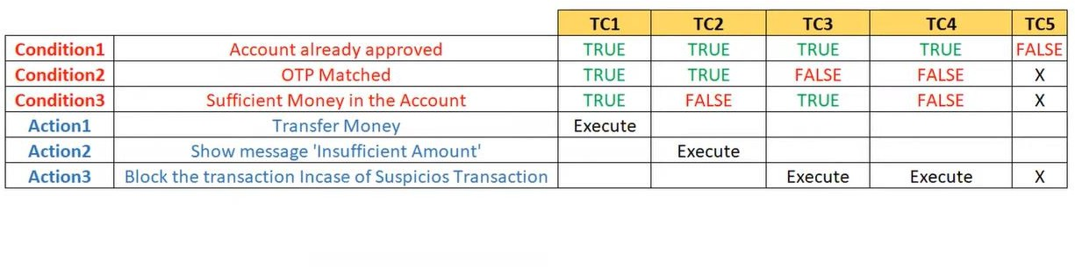
And the actions performed are,
Transfer money.
Show a message as the insufficient amount.
Block the transaction in case of a suspicious transaction.
State Transition:
In State Transition Technique input is given in sequence one step at a time. Under this technique we can test for limited set of input values.
The technique should be used when the testing team wants to test sequence of events
which happen in the application under test.
The tester can perform this action by entering various input conditions in a sequence.
In the State transition technique, the testing team provides positive as well as negative input test values for evaluating the system behavior.
Shrikant S.
sssnashik@gmail.com

Slide 28
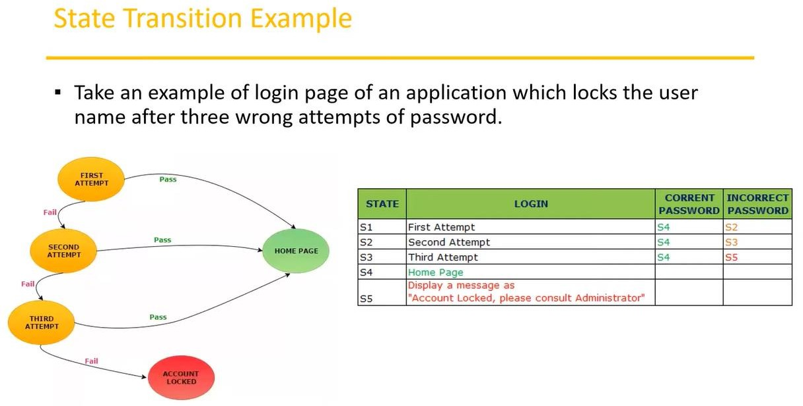
Error Guessing:
Error guessing is one of the testing techniques used to find bugs in a software application based on the tester's prior experience.
In Error guessing we do not follow any specific rules.
It depends on Tester’s Analytical skills and experience.
Some of the examples are,
Submitting a form without entering values.
Entering invalid values such as entering alphabets in the numeric field.
=============================================================================
Shrikant S.
sssnashik@gmail.com

Slide 29
Non- Functional Testing:
Performance Testing:
Testing the performance of an application by providing some workload (number of users).
Load Testing:
If workload is between the limits.
Stress Testing:
If the workload is beyond the limits.
Compatibility Testing:
Testing the app whether it works on different OS, devices, different browsers and its versions.
Usability Testing:
It is done to test whether the application is user-friendly.
Scalability Testing:
If the number of users is to the maximum limit, to test the system is not getting crash or not.
Stability Testing:
To test the application is stable or not, when we give the maximum workload.
Automation Testing:
It is the application of software tools to automate a human-driven manual process of reviewing and validating a software product.
It is used to reduce the testing efforts, also testing faster delivery capability.
A U ĪH O R
M A R I Y A M M A Į f

Slide 30
What is your (QA/Tester) basic roles and responsibility?
Understanding & analyzing Test Requirements.
Prepare Test Scenarios for individual modules.
Writing & review the Test Cases as per requirements.
Test cases execution.
Defect creation, Defect verification, and QA task management.
Weekly Test status reporting.
Continuous Communication with the team & client.
Preparation of Test Plan Documentation (if have 3+ years exp).
What is a Build?
It is a number/identity given to Installable software that is given to the testing team by the development team
What is release?
It is a number/ identity given to Installable software that is handed over to the customer/client by the testing team (or sometimes directly by the development team)
Which tools you are using to write review test cases?
Generally, in our company we preferred to write down test cases in an excel sheet because it’s very easy and user-friendly. After completion of the review, we will add that test cases in TestLink for future tracking purposes.
TestLink
Version: -1.9.13
What is deployment?
Deployment is the mechanism through which applications, modules, updates, and patches are delivered from developers to end-user/client/customer.

Slide 31
Test Plan template
Contents: (WHAT to test, HOW to test, WHEN to test):
Overview
Scope
Inclusions
Exclusions
Test Environments
Test Approach/Strategy
Defect Reporting Procedure
Roles/Responsibilities
Test Schedule
Test Deliverables
Pricing
Entry and Exit Criteria
Suspension and Resumption Criteria
Tools
Risk and Mitigations
Approvals
=============================================================================
Use Case, Test Scenario, and Test Case:
Use Case: (Describes the requirement)
Use case describes the requirement.
Use case contains three items.
Actor, who is the user, who can be a single person or a group of people, interacting with a process.
Action, who is to reach the final outcome.
Goal/Outcome, which is the successful use outcome.
Shrikant S.
sssnashik@gmail.com

Slide 32
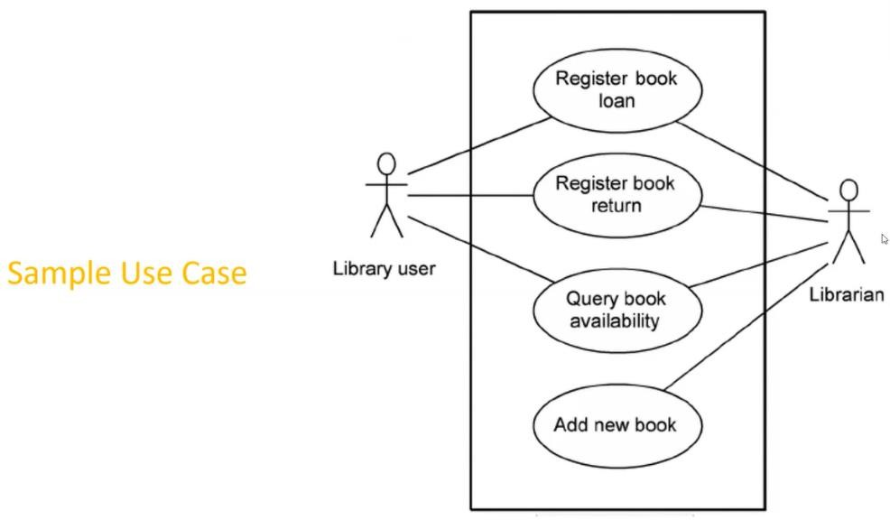
2. Test Scenario: (What to test)
A
Test Scenario is an overview of any functionality in a software application that is under testing.
A test scenario is derived from a use case.
We can say the test scenario contains all the conditions, which can be determined the testing coverage against the business requirement.
possible area
to be tested (What to test).
Test Case: (How to test)
It is detailed description of any functionality for how to test.
A Test Case is a set of actions executed to validate a particular feature or functionality of your software application.
Step by step actions to be performed to validate the functionality of (How to test).
Test case contains test steps, expected result, and actual result. e.
AUT
It contains many details like, pre-condition, test data, expected result, actual result, status etc.
Use Case V/s Test Case
Use Case: Describes functional requirement, prepared by Business Analyst (BA).
Test Case: Describes Test Steps/Procedure, prepared by Testers.
Test Scenario V/s Test Case
Test Scenario is "What to be tested" and Test Case is "How to be tested".
Shrikant S.
sssnashik@gmail.com

Slide 33
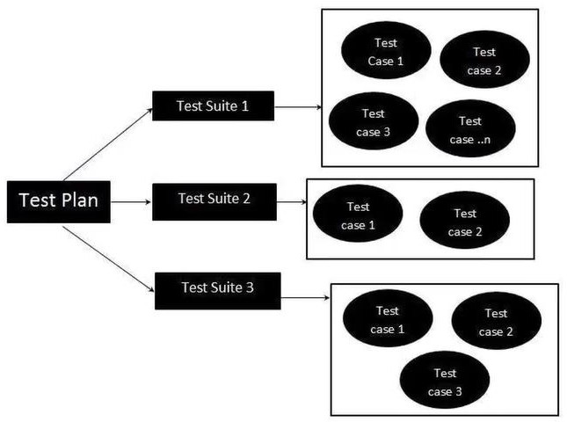
Test Suite (Test Bed):
Test Suite is a group of test cases that belong to the same category.
=============================================================================
Test Case (Writing) Contents:
Test Case ID
Test Case Title
Description
Pre-condition
Priority (P0, P1, P2, P3) - order (P0 - Smoke and Sanity, P1 - Regression, P2 - Functional, P3 - UI)
Requirement ID
Steps/Actions
Expected Result
Actual Result
Test Data
[ADD TEST CASE BHUSHAN TEMPLATE]
Shrikant S.
sssnashik@gmail.com

Slide 34
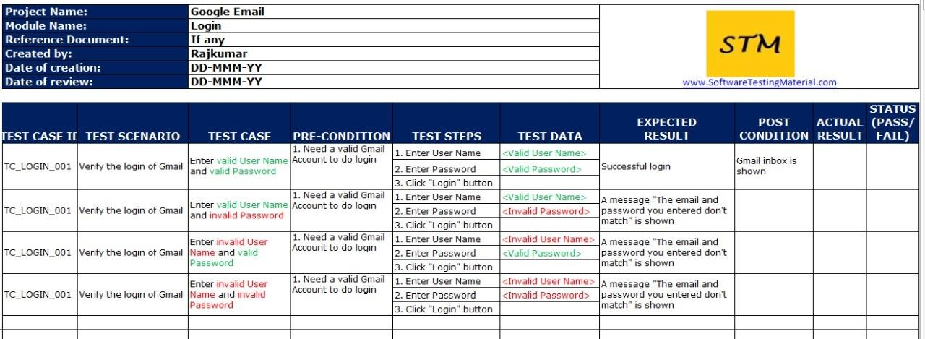

Slide 35
Why the software has bugs?
Software complexity
Programming errors
Changing requirements
Lack of skilled testers
Why does defect/bug occur?
In software testing, the bug can occur for the following reasons:
Wrong coding
Missing coding
Extra coding
=============================================================================
Defects/Bugs/Issues:
Any mismatched functionality found in an application is called a Defect/Bug/Issue.
During Test Execution Test engineers are reporting mismatches as defects to developers through templates or using tools.
Defect Reporting Tools:
Clear Quest
DevTrack
Jira
Quality Center
Bug Zilla etc.
Test Management tools and Bug tracking tools are completely different.
Test (Case) Management Tool Vs. Project Management Tool Vs. Bug Tracking Tool.
=============================================================================
Defect Report Contents:
Defect_ID
Defect Description
Version
Shrikant S.
sssnashik@gmail.com

Slide 36
Steps
Data Raised
Reference
Detected By
Status
Fixed By
Date Closed
Severity
Priority
=============================================================================
Defect Classification / Categorization:
Severity
Blocker (Show stopper)
Critical
Major
Minor
Priority
P1 (High)
P2 (Medium)
P3 (Low)
Shrikant S.
sssnashik@gmail.com

Slide 37
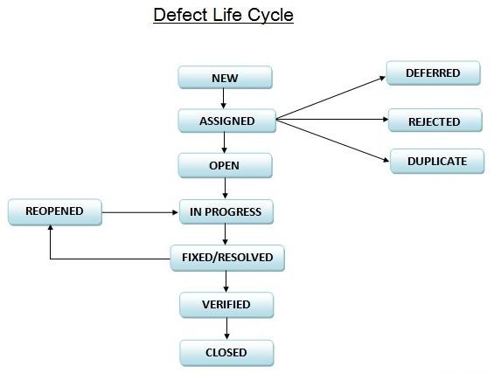
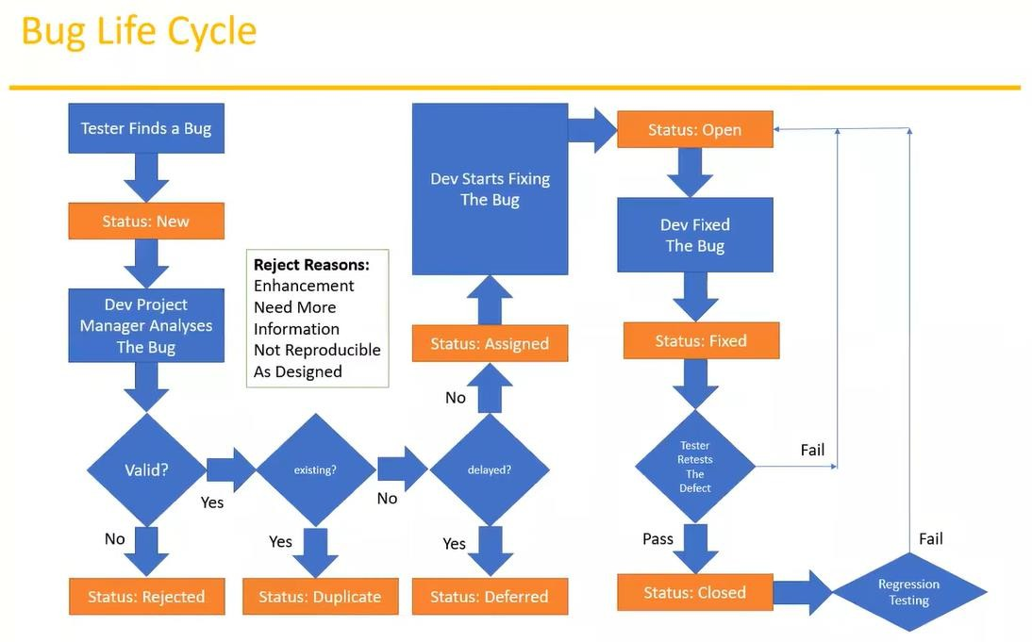
Shrikant S.
sssnashik@gmail.com

Slide 38
=============================================================================
Test Cycle Closure:
a. Activities:
Evaluate cycle completion criteria based on Time, Test coverage, Cost, Software Critical Business Objectives, Quality.
Prepare test metrics based on the above parameters.
Document the learning out of the project.
Prepare Test summary report.
Qualitative and quantitative reporting of quality of the work product to the customer.
The result analysis to find out the defect distribution by type and severity.
b. Deliverables:
Test Closure report.
Test metrics.
c. Test Metrics:
Shrikant S.
sssnashik@gmail.com

Slide 39
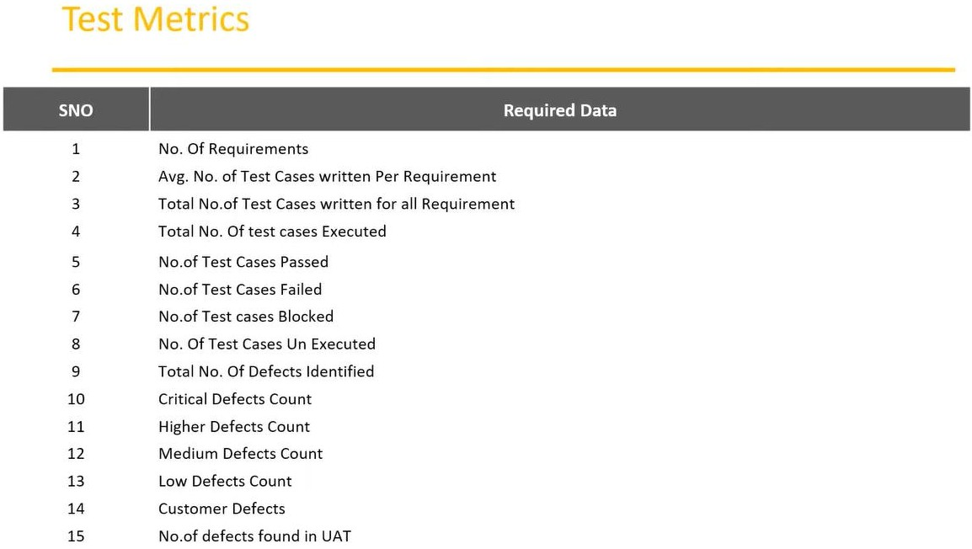
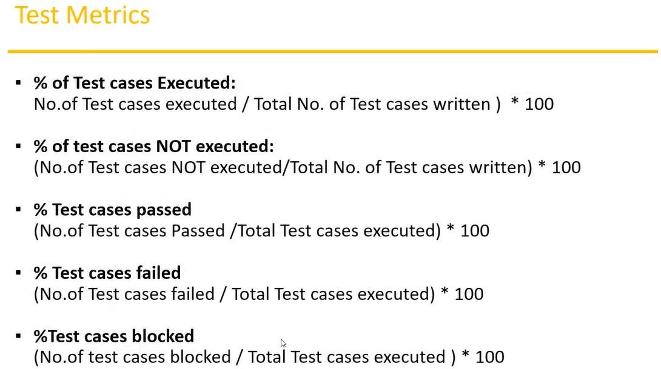
Shrikant S.
sssnashik@gmail.com

Slide 40
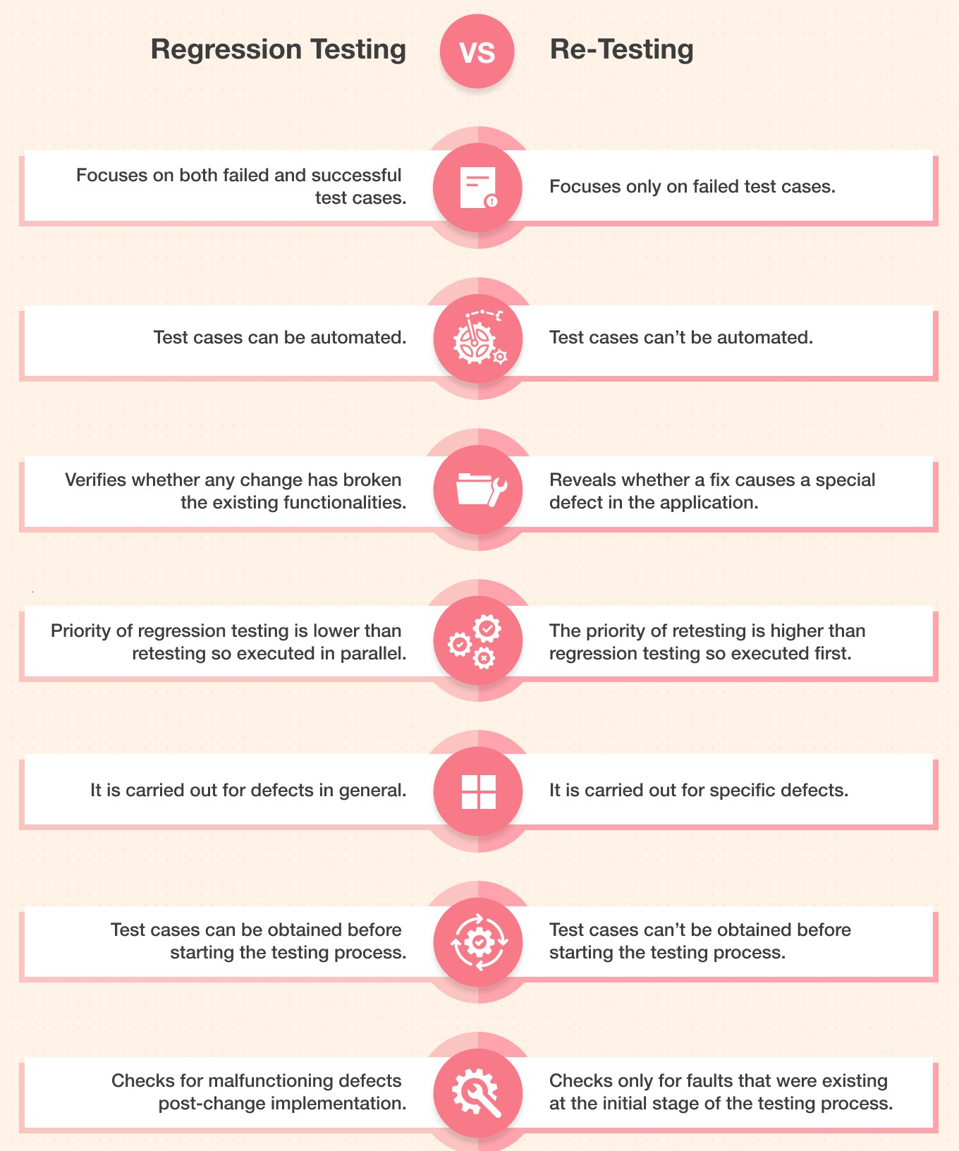
Example of Re-Testing Vs. Regression Testing:

Slide 41
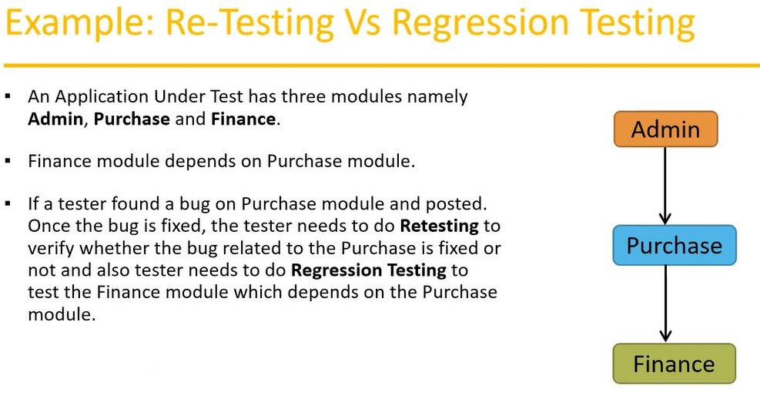
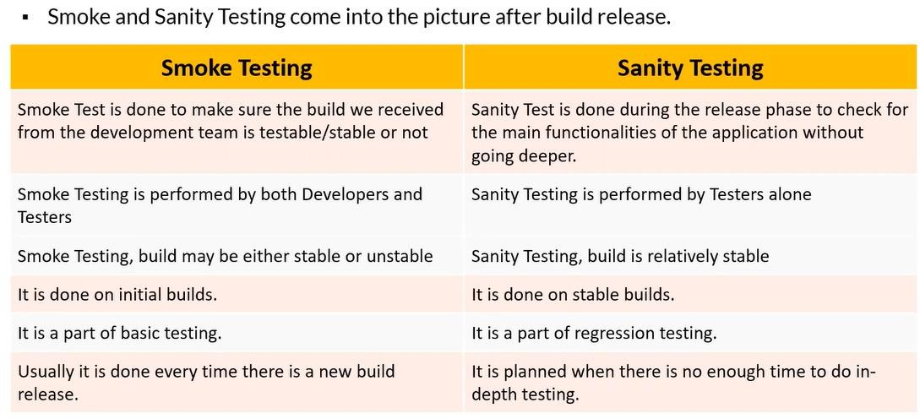
Smoke Vs. Sanity Testing:

Slide 42
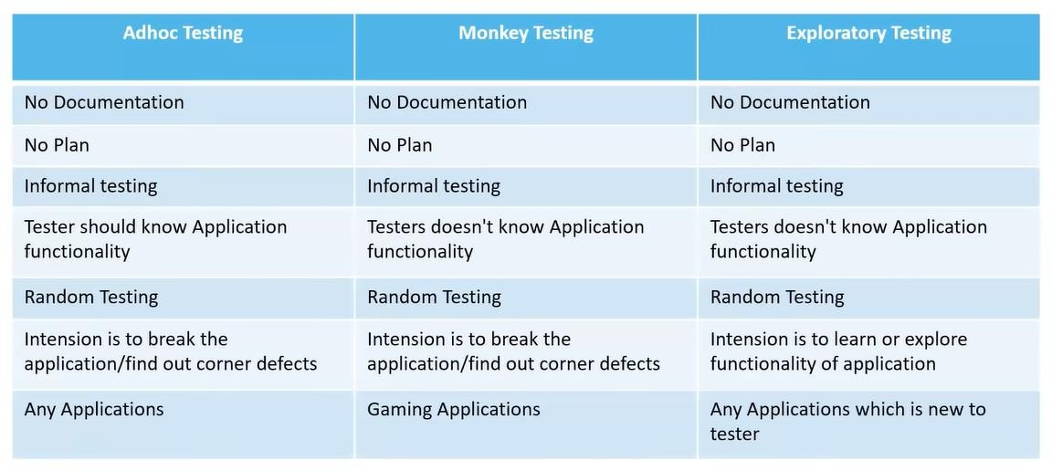
Tester should have knowledge of application even though he does not have requirements/test cases.
This testing is usually an unplanned activity.
Monkey/Gorilla Testing:
Testing applications randomly without any test cases or any business requirement.
Adhoc testing is an informal testing type with an aim to break the system.
Tester does not have knowledge of the application.
Suitable for gaming applications.
Adhoc Testing Vs. Monkey Testing Vs. Exploratory Testing
Positive Testing:
Testing the application with valid inputs is called positive testing.
It checks whether an application behaves as expected with positive inputs.
Negative Testing
Testing the application with invalid inputs is called negative testing.
It checks whether an application behaves as expected with the negative testing.

Slide 43
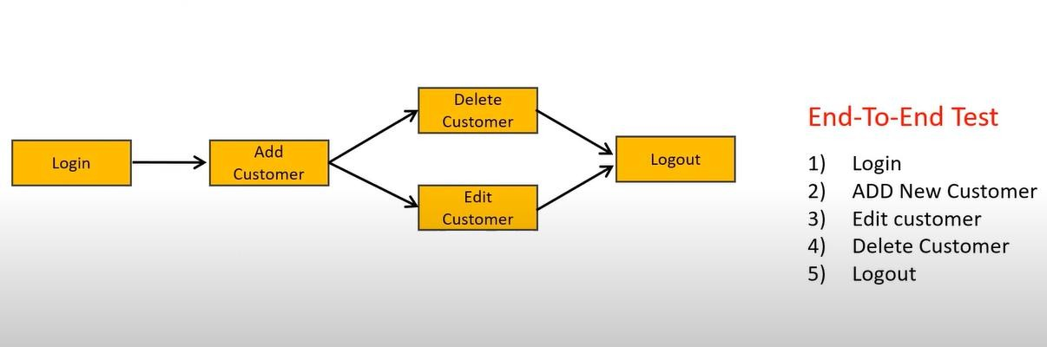
Positive Vs. Negative Test Cases:
For example, if a text box is listed as a feature and in FRS it is mentioned as a Text box that accepts 6-20 characters and only alphabets.
Positive Test Cases:
Textbox accepts six characters.
Textbox accepts up to 20-character lengths.
Textbox accepts any value between 6-20 characters long.
Textbox accepts all alphabets.
Negative Test Cases:
Textbox should not accept less than 6 characters.
Textbox should not accept characters more than twenty characters.
Textbox should not accept special characters.
Textbox should not accept numerically.
End to End Testing:
Testing the overall functionalities of the system including the data integration among all the modules are called end-to-end testing.

Slide 44
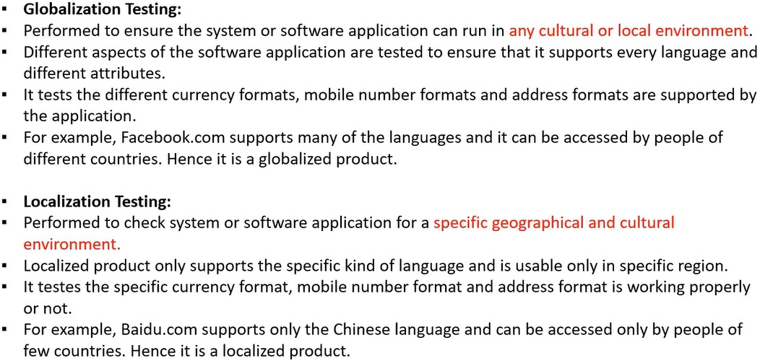
i. Globalization and Localization Testing:
=============================================================================
Agile – Scrum
Agile Model/Agile Methodology/Agile Process:
Agile is an approach to software development under which requirements and solutions evolve through the collaborative effort of self-organizing and cross-functional teams and their customer/end customer.
Both development and testing activities are done parallelly and collaboratively.
In Agile, instead of BA’s, the Product Owner collects and discusses with the customer/end client.
It’s a Quick assign Quick Design model.
Agile model is combination of Iterative and Incremental model.
Agile Principles:
Requirement changes are accepted from the customer.
So, the customer no need to wait, which provides customer satisfaction.
We develop, test, and release pieces of software to the customer with some features.

Slide 45
The Whole team works together toward achieving one goal.
Here we focus on F2F conversation.
We follow iterative and incremental nature.
Advantages of Agile Model:
We can accept/accommodate the required changes in the middle of development.
Release will be very fast.
So, the customers no need to wait for a long time.
Create good communication between teams.
Easy model to adapt.
It is suitable for both small and large software development projects.
Disadvantages of Agile Model:
Less focus on design and documentation, as we focus on fast delivery of the software.
Project can easily go out of track if the customer representative is not clear about what final outcome they want.
Development Task:
Review the story
Estimate the story
Design
Code
Unit Testing
Integration Testing etc.
QA Task:
Review the story
Test Cases
Test Scenarios
Test Data
Test Review
Test Environments
Execute Test Cases
Report Bugs etc.
=============================================================================

Slide 46
Different Types of test plans in software testing?
Test plans can be used as supporting documentation for an overall testing objective (a master test plan) and specific types of tests (a testing type-specific plan).
Master test plan: A master test plan is a high-level document for a project or product’s overall testing goals and objectives. It lists tasks, milestones, and outlines the size and scope of a testing project. It encapsulates all other test plans within the project.
Testing type-specific plan: Test plans can also be used to outline details related to a specific type of test. For example, you may have a test plan for unit testing, acceptance testing, and integration testing. These test plans drill deeper into the specific type of test being conducted.
What are the important tasks in the Test Planning stage?
Understanding and analyzing the requirements
Risk Analysis
Test Estimations (Scope of the project, Time, Budget, Available resources)
Team formation
Test Approach (Strategy) Implementation
Defining Test Environment setup
Traceability Matrix
Test Plan Documentation
What are the reference documents for Test Planning?
Reference Documents for Test Planning stage:
Requirements
Project Plan
Test Strategy
—
Design docs
Process guidelines docs
Corporate standards docs, etc.
What is Test Point Analysis?
A formula-based test estimation method based on function point analysis.

Slide 47
What is Software Test Process?
The fundamental test process comprises test planning and control, test analysis and design, test implementation and execution, evaluating exit criteria and reporting, and test closure activities.
What is Function Point Analysis?
A Method aiming to measure the size of the functionality of an information system. The measurement is independent of the technology. This measurement may be used as a basis for the measurement of productivity, the estimation of the needed resources, and project control.
What are the Entry criteria in Test Plan?
The set of generic and specific conditions for permitting a process to go forward with a defined task, e.g., test phase.
The purpose of entry criteria is to prevent a task from starting which would entail more (wasted) effort compared to the effort needed to remove the failed entry criteria.
What is Exit criteria in Test Plan?
The set of generic and specific conditions, agreed upon with the stakeholders, for permitting a process to be officially completed. The purpose of exit criteria is to prevent a task from being considered completed when there are still outstanding parts of the task that have not been finished. Exit criteria are used to report against and to plan when to stop testing.
What is a Test deliverable?
Any test (work) product must be delivered to someone other than the test (work) product’s author.
What are the Test deliverables in Software Test Process?
Test deliverables are nothing, but the documents prepared after testing. Test deliverables will be delivered to the client not only for the completed activities but also for the activities, which we are implementing for better productivity.
Some Test Deliverables in the project are,
Test deliverables

